Slide 1
AI Labs

Slide 2

Index
Download and Run a Model on Local
What is Model, FM, LLM ?
What is Foundation Model ?
How to create it ?
How it works ?
What are weights in Model ?
What are technologies ?
How/Where to deploy a model ?
How to Donate to Army ?

Slide 3
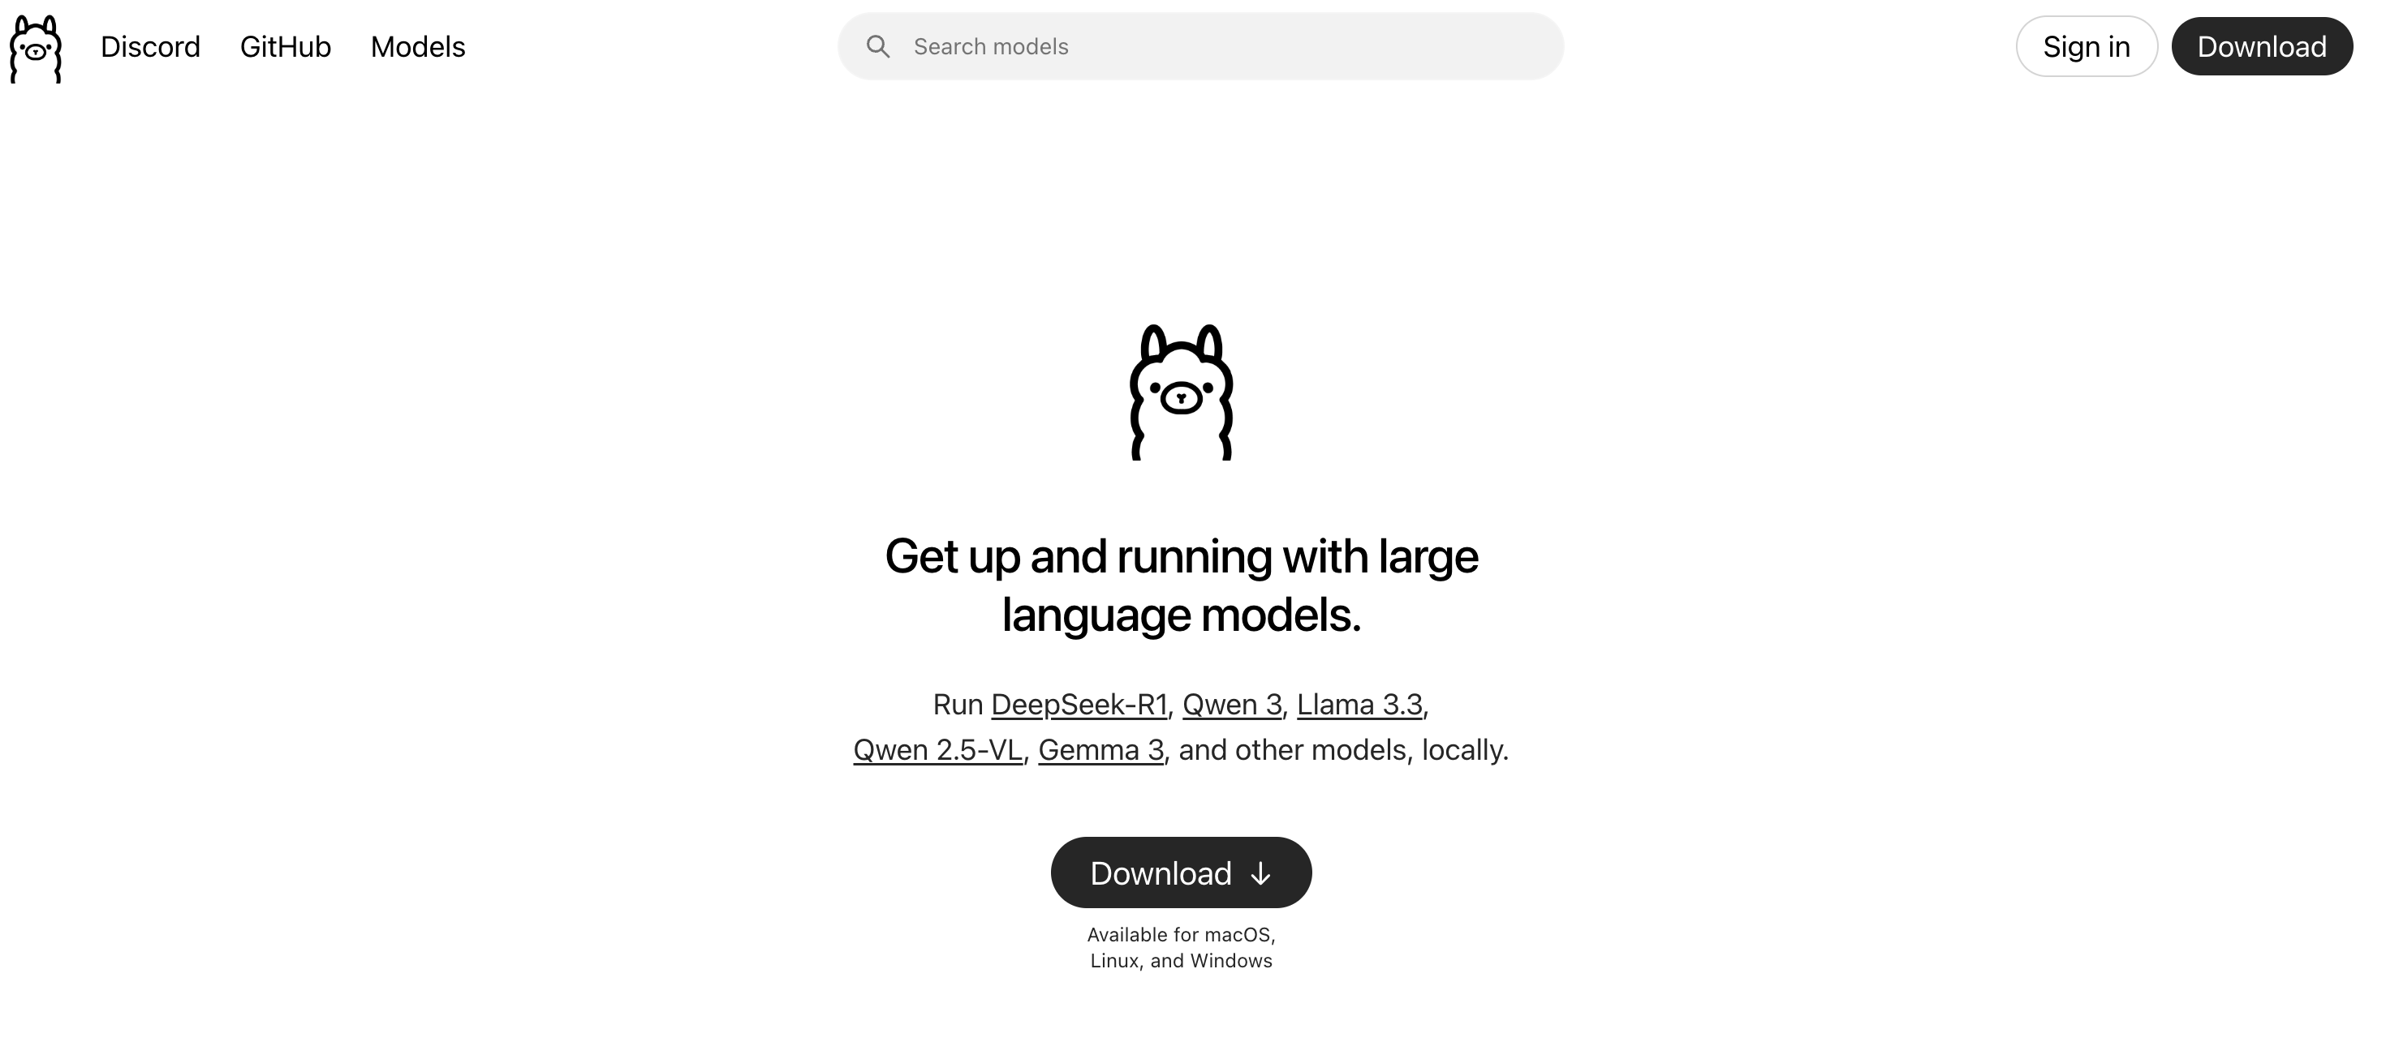
Demo
https://ollama.com/

Slide 4
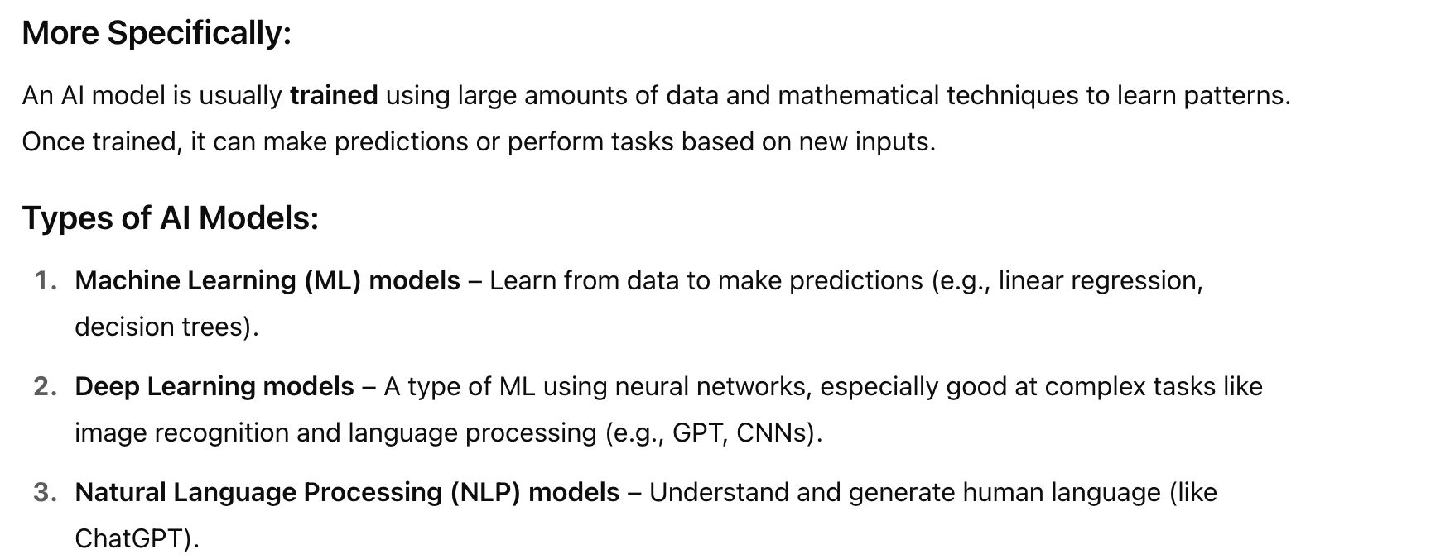
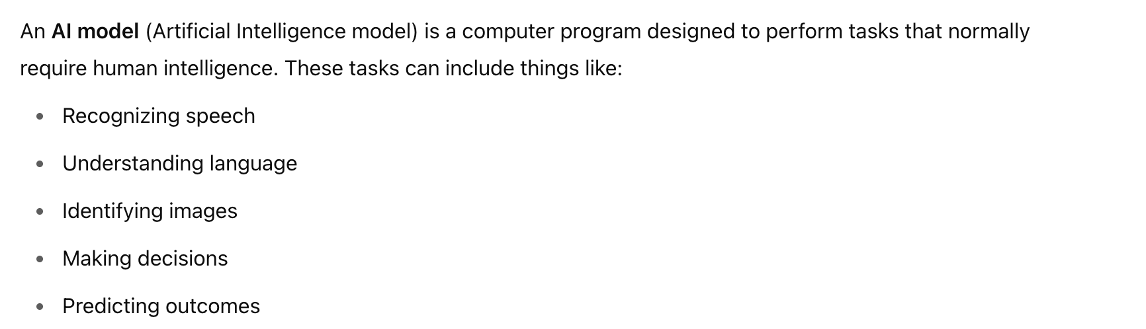
What is AI Model

Slide 5
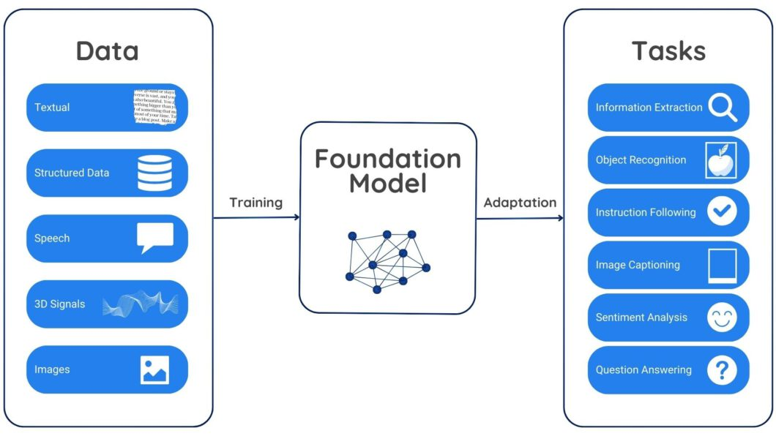
What is a FM

Slide 6
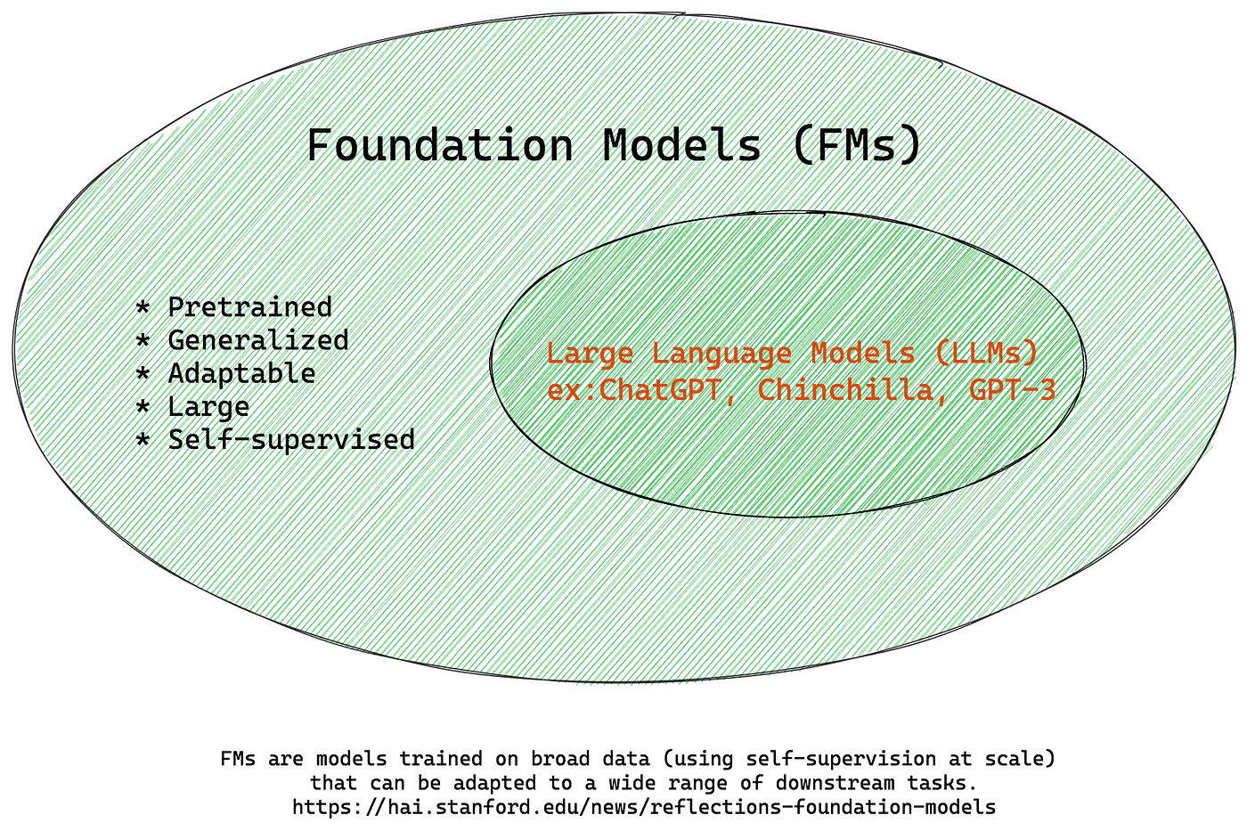
What is LLM

Slide 7
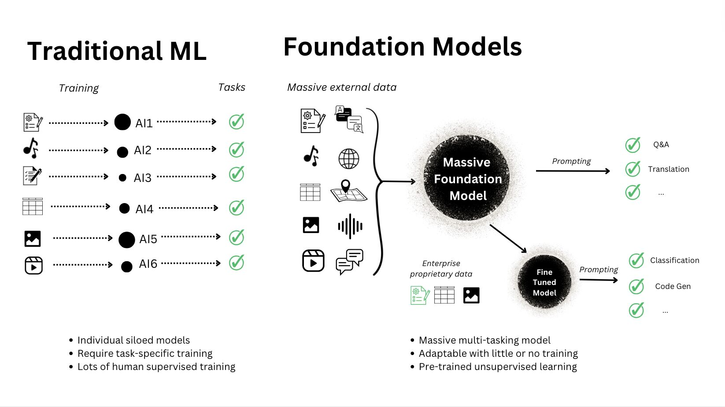
Tell me more

Slide 8
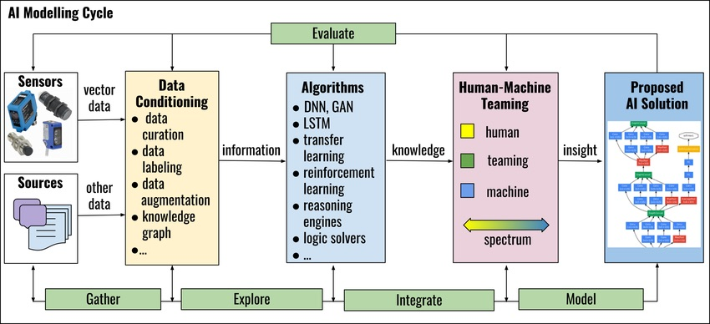
Step to make a model
Notes:
https://www.researchgate.net/figure/Steps-of-Developing-AI-Models_fig2_348142248

Slide 9

What is Weight in LLM
https://www.youtube.com/watch?v=LPZh9BOjkQs

Slide 10
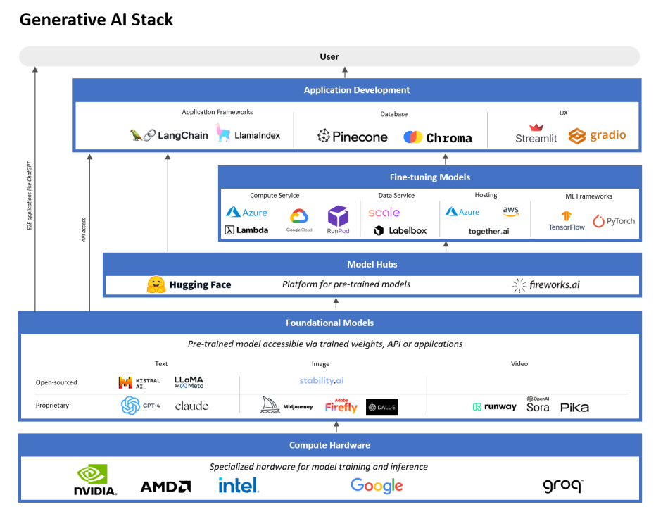
Technologies
UI/UX
Stremlit, Chainlit
Angular, React etc
Programming Languages
Python – Popular.
R, Java, C++ etc
Libraries & Frameworks
TensorFlow
PyTorch
Scikit-learn
Keras etc
Data Handling Tools
Pandas
NumPy
SQL / NoSQL/Vector databases
Compute Platforms
GPUs .
TPUs.
Cloud Platforms
AWS, GCP, Azure etc.
Model Training & Experiment Tracking
Jupyter Notebooks
MLflow / Weights & Biases
Docker / Kubernetes

Slide 11
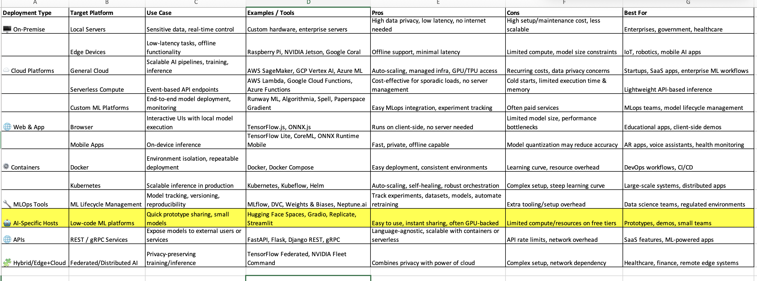
Where to deploy and get more details

Slide 12

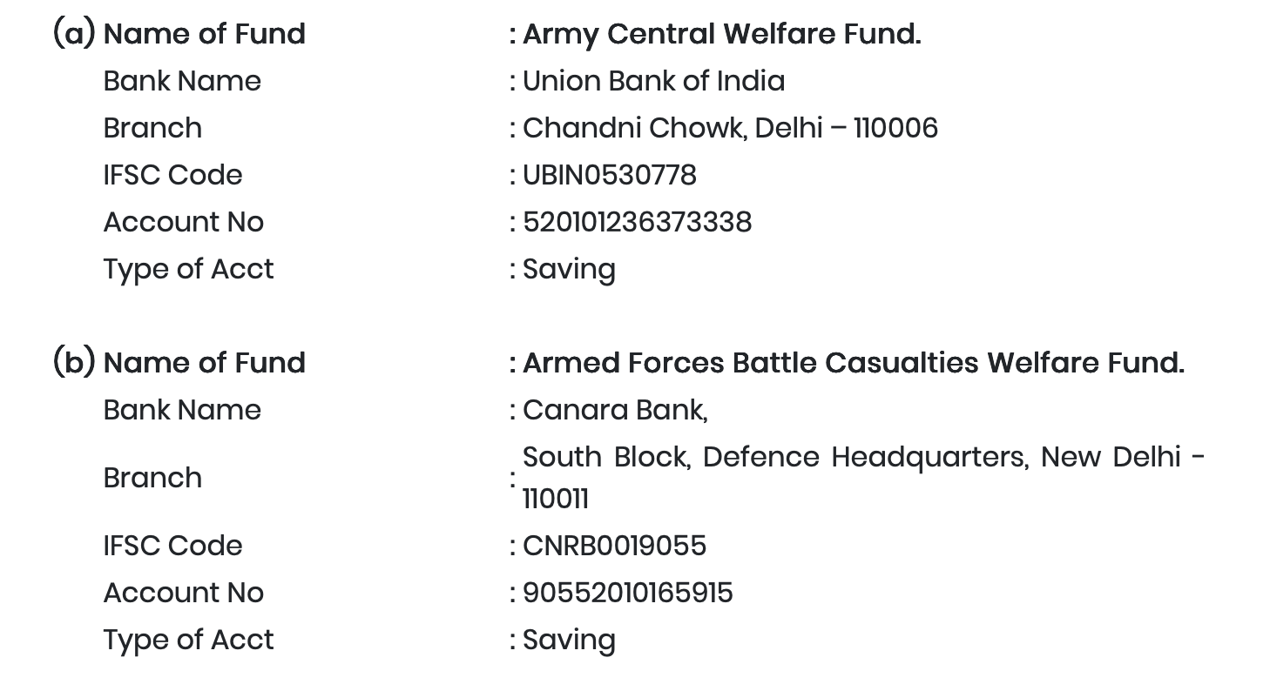
Donate to India Army
Indian Army
NDF - National Defense Fund

Slide 13

End

